Slide 1
The Limits to Growth: Sustainability and the Circular Economy
Lecture 3: Challenges II: Natural Resources and Pollution
Prof. Dr. Benjamin Leiding
M.A. Theresa Sommer

Slide 2
License
This work is licensed under a Creative Commons Attribution-ShareAlike 4.0 International License. To view a copy of this license, please refer to https://creativecommons.org/licenses/by-sa/4.0/ .
Updated versions of these slides will be available in our Github repository.

Slide 3
E02 – Your Personal Carbon Footprint

Slide 4
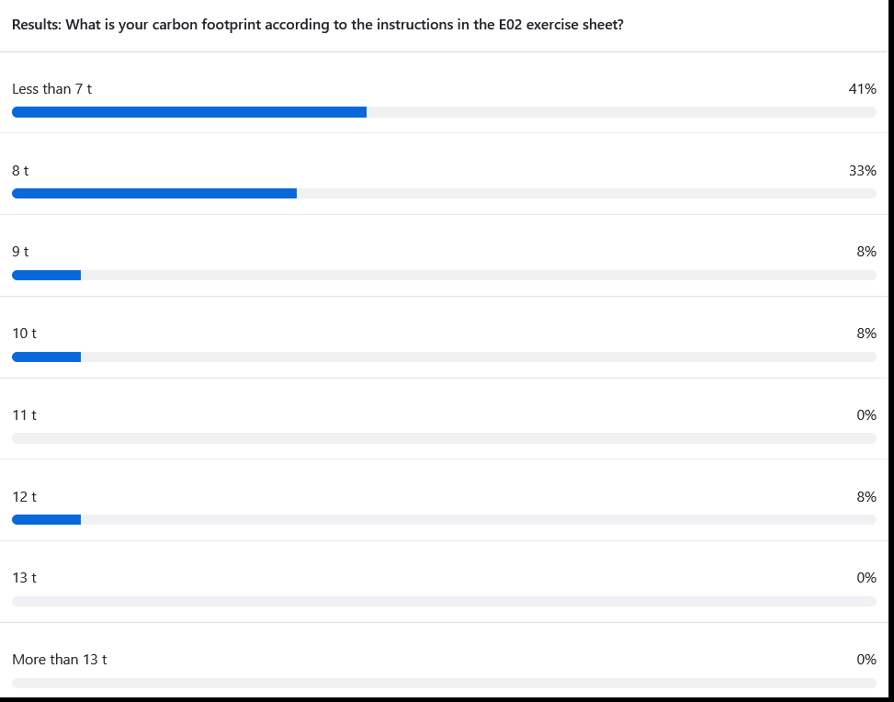
Your Personal Carbon Footprint
Results E02

Slide 5
Your Personal Carbon Footprint
Problem already solved?
So we just reduce our CO2 footprint and we are good?

Slide 6
Your Personal Carbon Footprint
Microsoft will be Carbon Negative by 2030
“By 2030 Microsoft will be carbon negative, and by 2050 Microsoft will remove from the environment all the carbon the company has emitted either directly or by electrical consumption since it was founded in 1975.”
https://blogs.microsoft.com/blog/2020/01/16/microsoft-will-be-carbon-negative-by-2030/

Slide 7
Your Personal Carbon Footprint
Apple will be Carbon Neutral by 2030
“Apple today unveiled its plan to become carbon neutral across its entire business, manufacturing supply chain, and product life cycle by 2030. The company is already carbon neutral today for its global corporate operations, and this new commitment means that by 2030, every Apple device sold will have net zero climate impact.”
July 2020
https://www.apple.com/newsroom/2020/07/apple-commits-to-be-100-percent-carbon-neutral-for-its-supply-chain-and-products-by-2030/

Slide 8
Your Personal Carbon Footprint
Polestar – 2030 Climate-neutral Car
“...we’re embarking on our greatest journey so far: challenging ourselves to create a climate-neutral car by 2030, by reducing emissions throughout supply chain and production.”
https://www.polestar.com/uk/news/striving-for-zero-the-2030-climate-neutral-car-plan/

Slide 9
Your Personal Carbon Footprint
Polestar – 2030 Climate-neutral Car
“...we’re embarking on our greatest journey so far: challenging ourselves to create a climate-neutral car by 2030, by reducing emissions throughout supply chain and production.”
“Relying on the current trend of offsetting by planting trees is not sustainable in the long run. It would mean using too much land, and the long-term carbon-storage capacity of forests and soils is not well known. Offsetting by planting trees also risks contributing to monocultures and loss of biodiversity. Additionally, there can be no guarantee that a forest won’t later be logged, devastated by a forest fire or altered by climate change.”
https://www.polestar.com/uk/news/striving-for-zero-the-2030-climate-neutral-car-plan/

Slide 10
Your Personal Carbon Footprint
Problem already solved?
It is not only about CO2…

Slide 11
Your Personal Carbon Footprint
Greenwashing?
Apple iPad Pro 11” 2018 | Gobs of adhesive hold most everything in place, making all repairs more difficult. The battery is secured with both easier-to-remove stretch-release tabs and conventional, non-removable adhesive. The USB-C port is modular and can be independently replaced.
Microsoft Surface Pro 6 2018 | All repairs require first removing the display assembly—which is stubbornly glued in place, expensive, and prone to shattering. The battery is firmly glued in place, with its connector pinned under the motherboard—requiring near-total disassembly for service. Once upon a time, Surface Pro storage was removable—but not in this version.
Apple iPad Air 3 2019 | Battery replacement is possible, but still unnecessarily difficult. Gobs of adhesive hold many parts and cables in place, complicating all repairs. Many components are modular and can be replaced independently, but the Lightning port is soldered to the logic board.
Apple iPad 7 2019 | As with all iPads, a solid barrier of very strong adhesive hinders all repairs. The Lightning port, a common point of failure, is soldered to the logic board. More adhesive holds nearly everything else in place. Battery and logic board replacements are particularly obnoxious.
Apple iPad Mini 5 2019 | Battery replacement is possible, but still unnecessarily difficult. Gobs of adhesive hold many parts and cables in place, complicating all repairs. Removing the home button is tough, and will be required for display replacement if you want to keep Touch ID functionality.
https://www.ifixit.com/tablet-repairability

Slide 12
A Lack of Resources

Slide 13
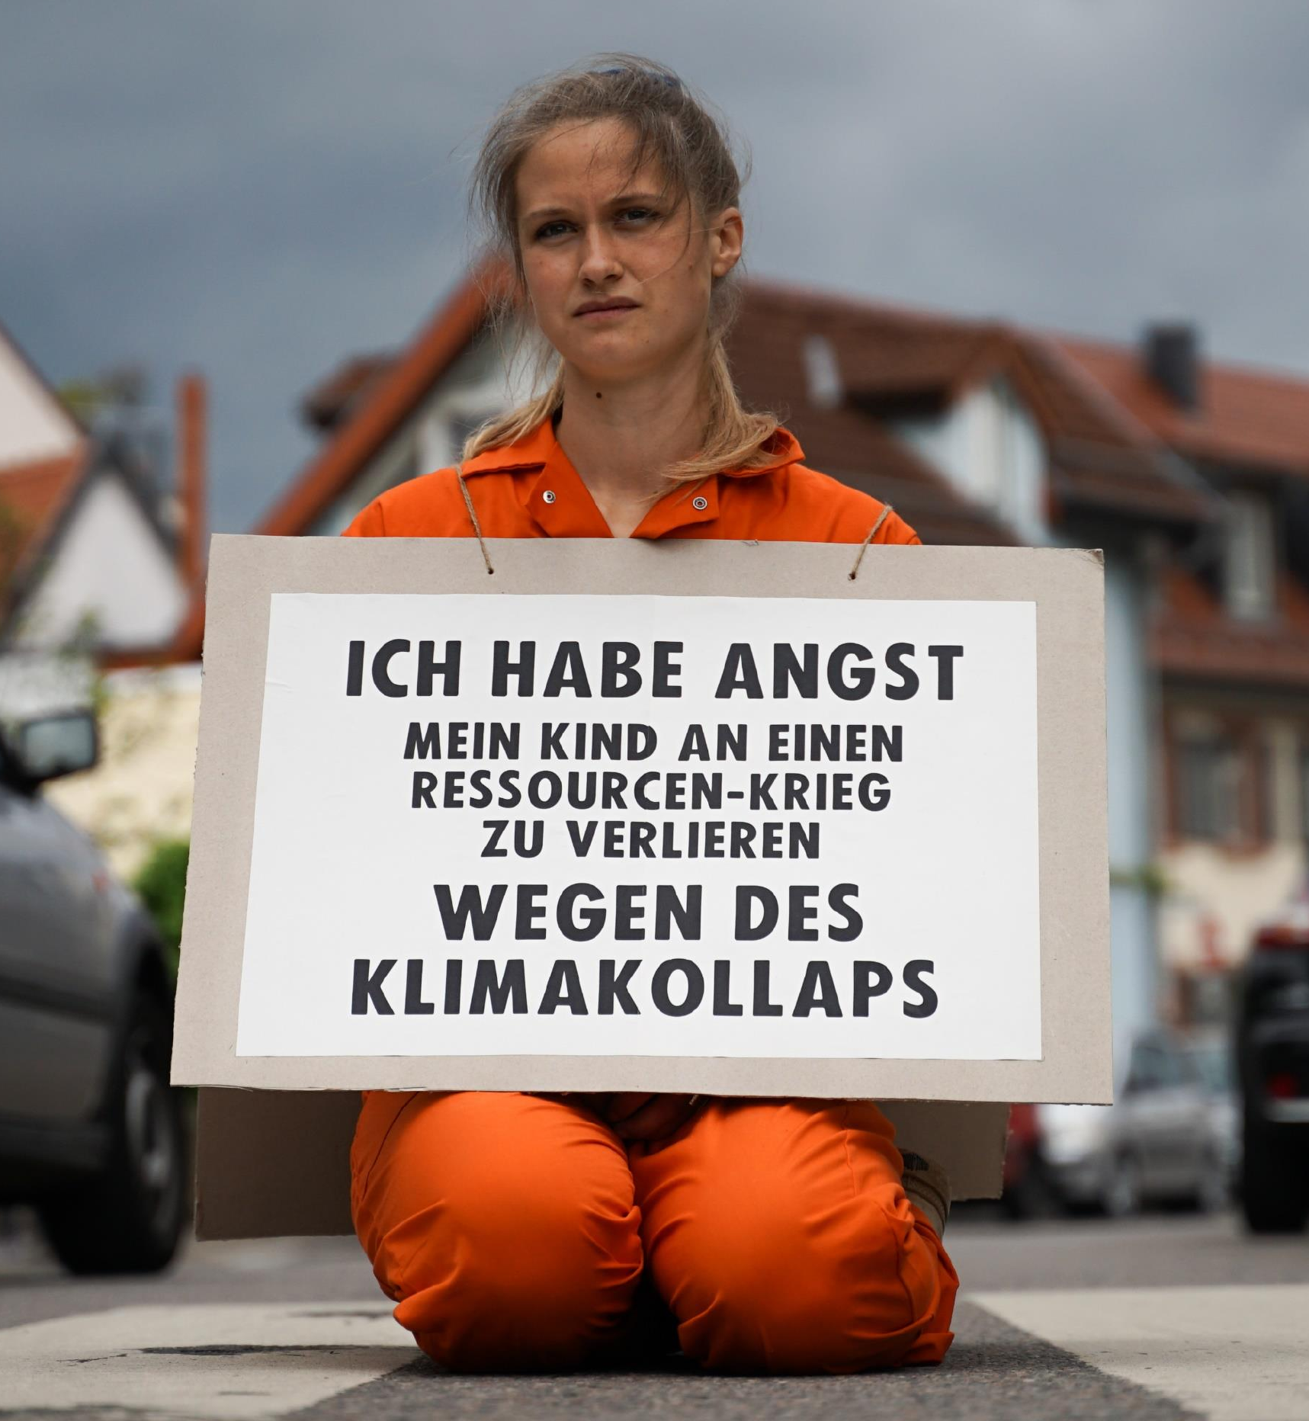
We only have one planet
Resources
“I am afraid of losing my child to a resource war because of a climate collapse”
→ “Our parents will die of old age, our children will die of climate change”
XR Strategiepapier 2022 – Pusteblumen und Hype. Bilder: Sebastian Höhn, Joe Pohl, Sandra Doneck, Alessandro Brönnimann

Slide 14
We only have one Planet
Resource Wars
“Resource wars are violent conflicts that are largely driven by competition for control over vital or valuable natural materials, such as oil, water, land, timber, animals (or animal products), gold, silver, gems, and other key minerals.”
Michael T. Klare, Barry S. Levy, Victor W. Sidel (2011) – The Public Health Implications of Resource Wars – Link.

Slide 15
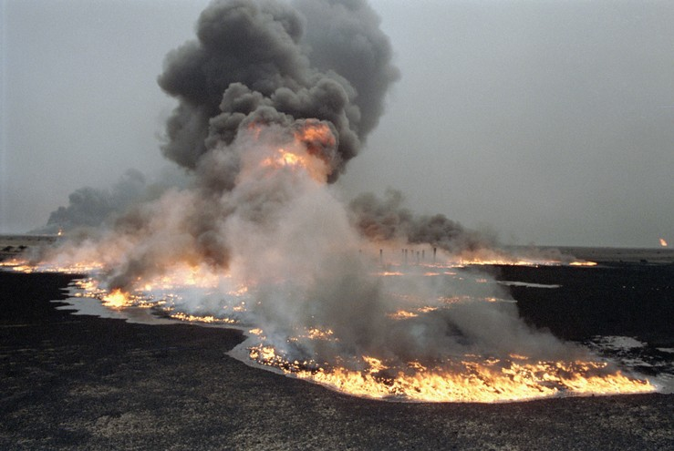
We only have one Planet
Resource Wars – Oil, etc.
United Nations Photo – https://www.flickr.com/photos/un_photo/5559102272 – CC BY-NC-ND 2.0.

Slide 16
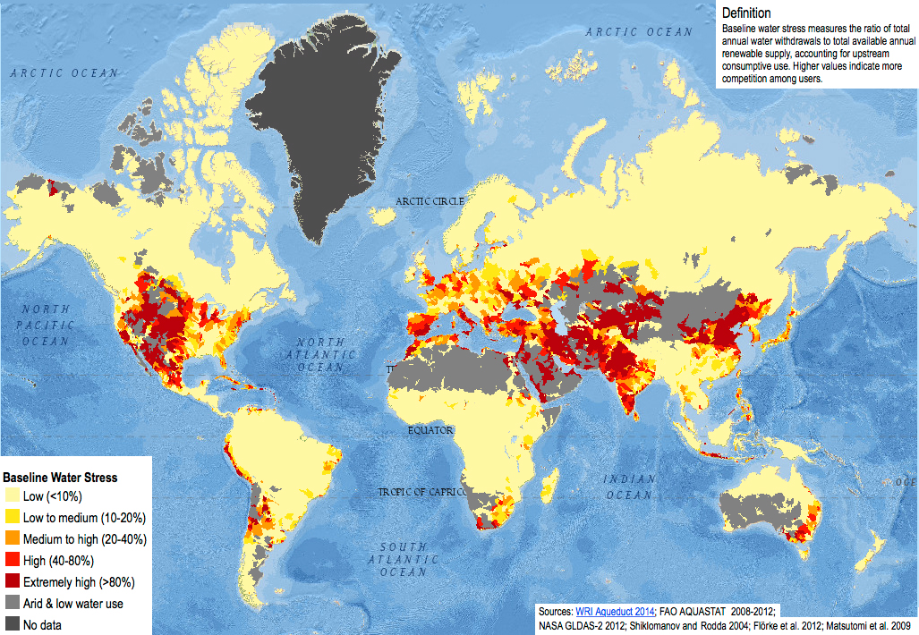
We only have one Planet
Resource Wars – Water
1. Sampa – https://commons.wikimedia.org/wiki/File:Baseline_water_stress.jpg – CC BY-SA 4.0.
2. Kgbo – https://commons.wikimedia.org/wiki/File:Closed_Wivenhoe_Dam_and_spillway,_August_2020.jpg – CC BY-SA 4.0.
3.Arian Zwegers – https://www.flickr.com/photos/azwegers/6226842732 – CC BY 2.0.

Slide 17
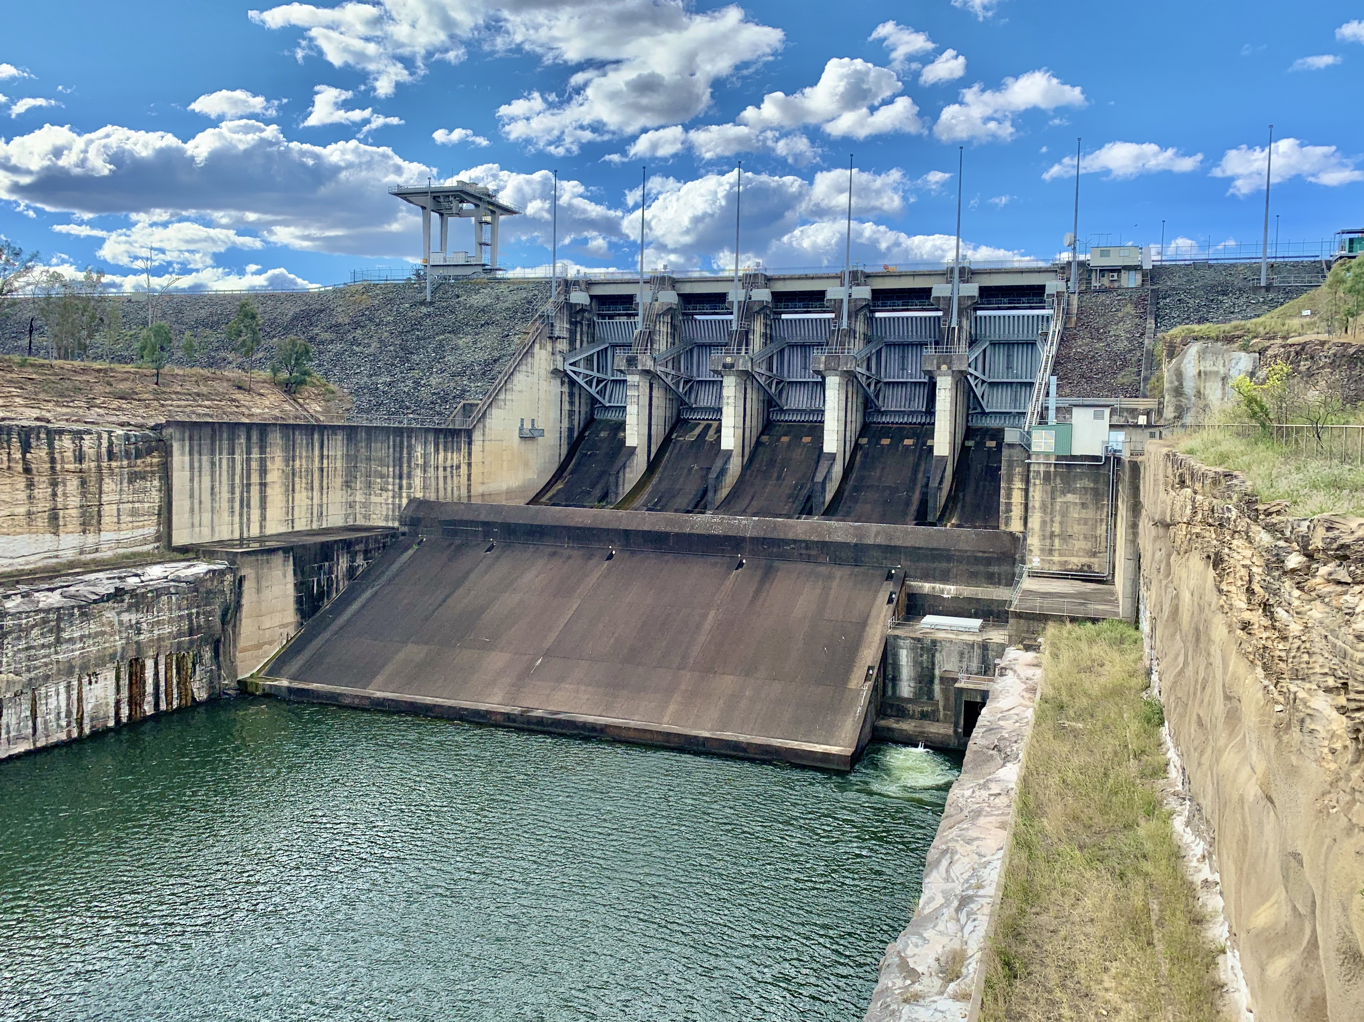
We only have one Planet
Resource Wars – Water
1. Sampa – https://commons.wikimedia.org/wiki/File:Baseline_water_stress.jpg – CC BY-SA 4.0.
2. Kgbo – https://commons.wikimedia.org/wiki/File:Closed_Wivenhoe_Dam_and_spillway,_August_2020.jpg – CC BY-SA 4.0.
3.Arian Zwegers – https://www.flickr.com/photos/azwegers/6226842732 – CC BY 2.0.

Slide 18
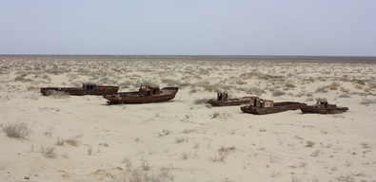
We only have one Planet
Resource Wars – Water
1. Sampa – https://commons.wikimedia.org/wiki/File:Baseline_water_stress.jpg – CC BY-SA 4.0.
2. Kgbo – https://commons.wikimedia.org/wiki/File:Closed_Wivenhoe_Dam_and_spillway,_August_2020.jpg – CC BY-SA 4.0.
3.Arian Zwegers – https://www.flickr.com/photos/azwegers/6226842732 – CC BY 2.0.

Slide 19
Environmental Pollution

Slide 20
Environmental Pollution
Definition
„Pollution, also called environmental pollution, the addition of any substance (solid, liquid, or gas) or any form of energy (such as heat, sound, or radioactivity) to the environment at a rate faster than it can be dispersed, diluted, decomposed, recycled, or stored in some harmless form.
The major kinds of pollution, usually classified by environment, are air pollution, water pollution, and land pollution.”
Nathanson, Jerry A.. "pollution". Encyclopedia Britannica, 22 Feb. 2022, https://www.britannica.com/science/pollution-environment. Accessed 11 April 2022.

Slide 21
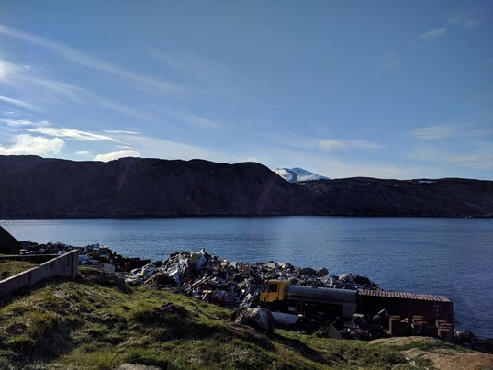
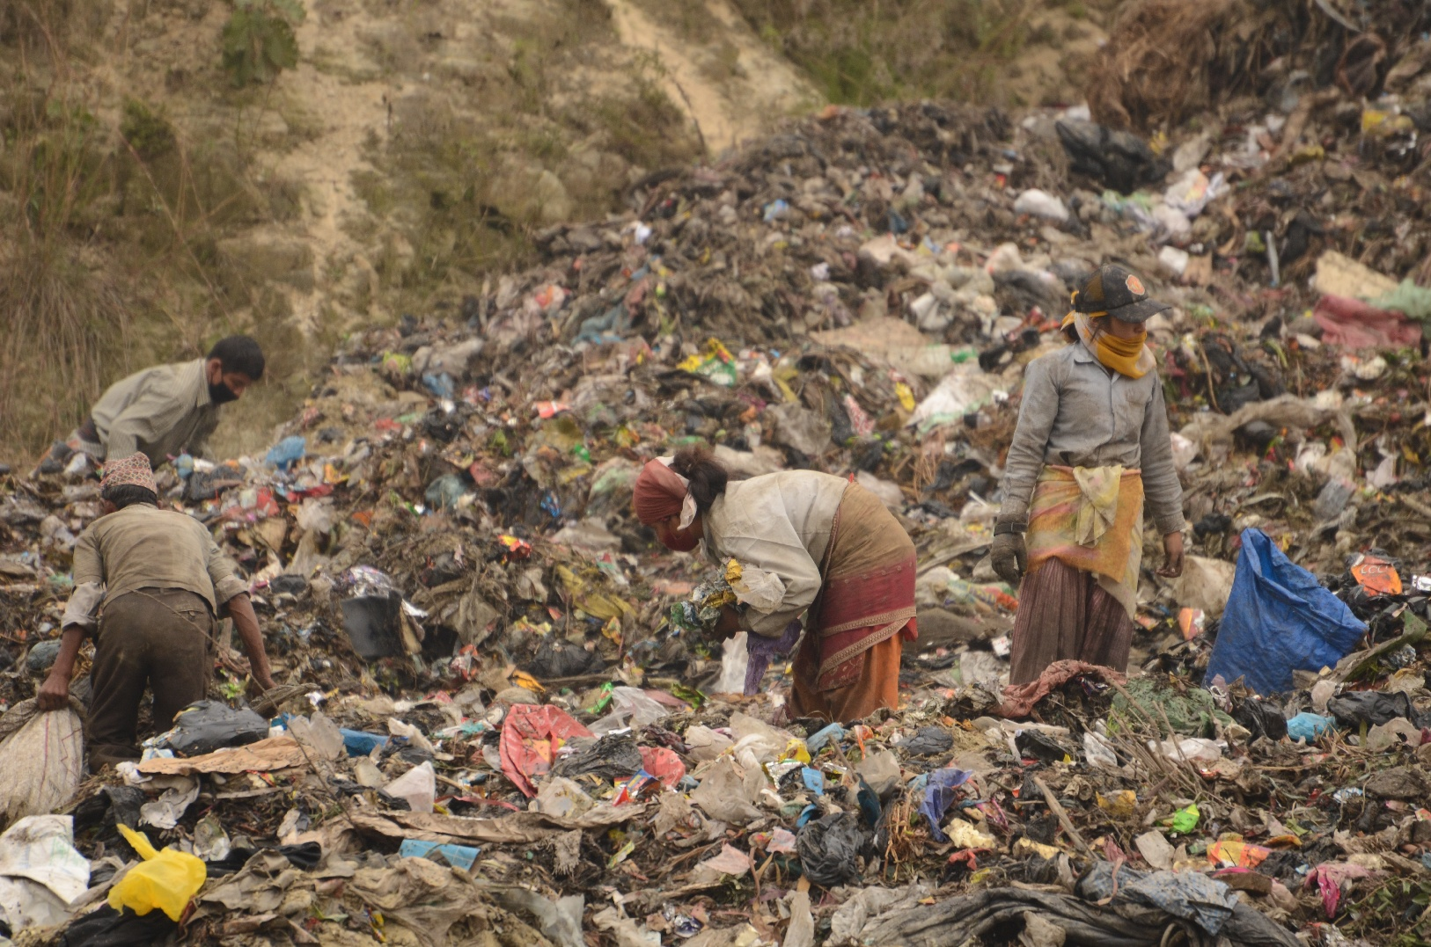
Environmental Pollution
Waste
1. "Landfill at Upernavik" by ulalume – https://www.flickr.com/photos/96649248@N00/43867280734 – CC BY-NC-ND 2.0.
2. Christian Hüpfer – https://flic.kr/p/aKXw2F – CC BY-SA 2.0.

Slide 22
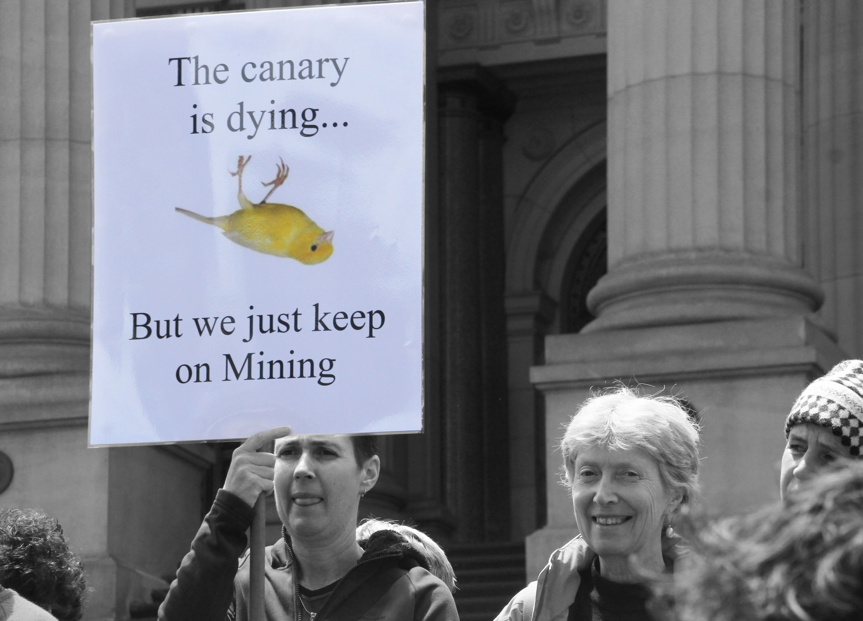
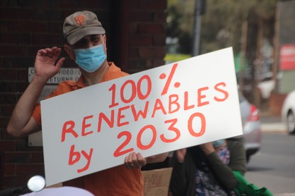
Environmental Pollution
Fossil Fuels
3 of the 10 dirtiest European coal plants are located in Poland
In which country/countries are the other 7 dirtiest coal plants located?
7 of the 10 dirtiest European coal plants are located in GERMANY
1. https://ember-climate.org/insights/research/top-10-emitters-in-the-eu-ets-2021/
2. John Englart – https://www.flickr.com/photos/takver/11308053925/ – CC BY-SA 2.0.
3. John Englart – https://www.flickr.com/photos/takver/51658831095/ – CC BY-SA 2.0.

Slide 23
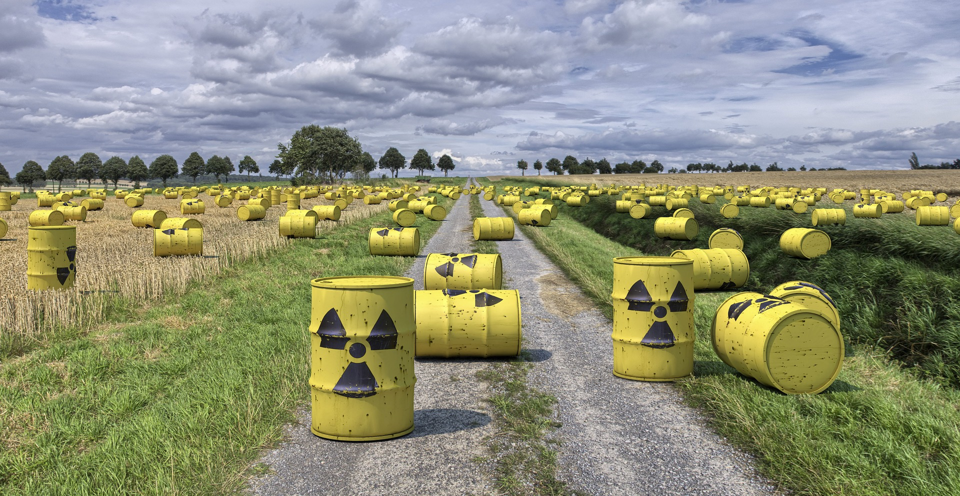
Environmental Pollution
Horrible Waste Management – Example 1

Slide 24
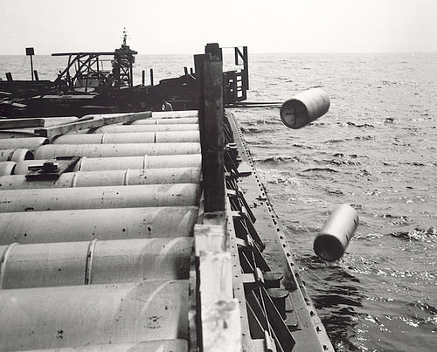
Environmental Pollution
Horrible Waste Management – Example 1
"Nuclear waste" by aaadrian365 is licensed with CC BY-NC 2.0. To view a copy of this license, visit https://creativecommons.org/licenses/by-nc/2.0/

Slide 25
Environmental Pollution
Horrible Waste Management – Example 1
→ 40,000 generations will have to live with the waste
→ 2 generations profited from cheap nuclear energy
https://www.spiegel.de/wissenschaft/technik/endlager-suche-was-wie-viel-und-wohin-damit-die-deutsche-atommuell-bilanz-a-7a153ba3-029a-4e55-adaf-3312b7427d9e

Slide 26
Environmental Pollution
Horrible Waste Management – Example 1
→ 40,000 generations will have to live with the waste
→ 2 generations profited from cheap nuclear energy
→ 40,000 generation will have to live with the waste
https://www.spiegel.de/wissenschaft/technik/endlager-suche-was-wie-viel-und-wohin-damit-die-deutsche-atommuell-bilanz-a-7a153ba3-029a-4e55-adaf-3312b7427d9e

Slide 27
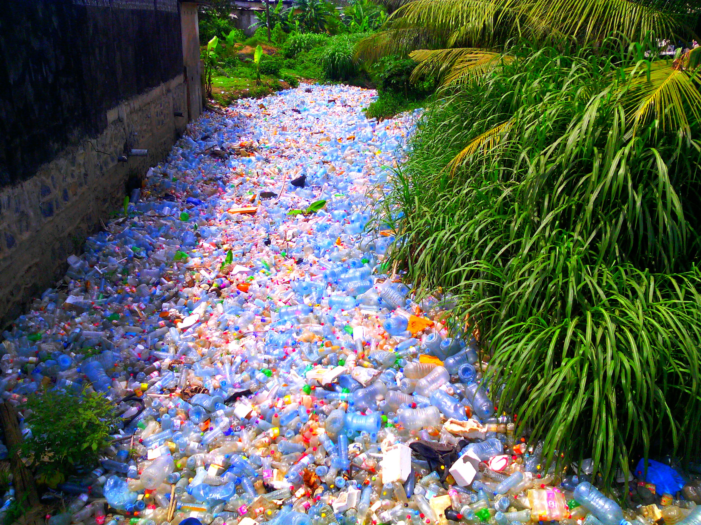
Environmental Pollution
Horrible Waste Management – Example 2
"Pollution Plastique" by Mouenthias is licensed with CC BY-SA 4.0. To view a copy of this license, visit https://creativecommons.org/licenses/by-sa/4.0/

Slide 28
Environmental Pollution
Horrible Waste Management – Example 2
We are consuming about 2000 tiny pieces of plastic every week.
That is a credit card every week!
That’s approximately 21 grams a month, or just over 250 grams a year.
"Pollution Plastique" by Mouenthias is licensed with CC BY-SA 4.0. To view a copy of this license, visit https://creativecommons.org/licenses/by-sa/4.0/
Wijnand de Wit and Nathan Bigaud for the WWF (2019) – No Plastic in Nature: Assessing Plastic Ingestion from Nature to People.

Slide 29
Environmental Pollution
Horrible Waste Management – Example 2
We are consuming about 2000 tiny pieces of plastic every week.
That is a credit card every week!
That’s approximately 21 grams a month, or just over 250 grams a year.
"Pollution Plastique" by Mouenthias is licensed with CC BY-SA 4.0. To view a copy of this license, visit https://creativecommons.org/licenses/by-sa/4.0/
Wijnand de Wit and Nathan Bigaud for the WWF (2019) – No Plastic in Nature: Assessing Plastic Ingestion from Nature to People.

Slide 30
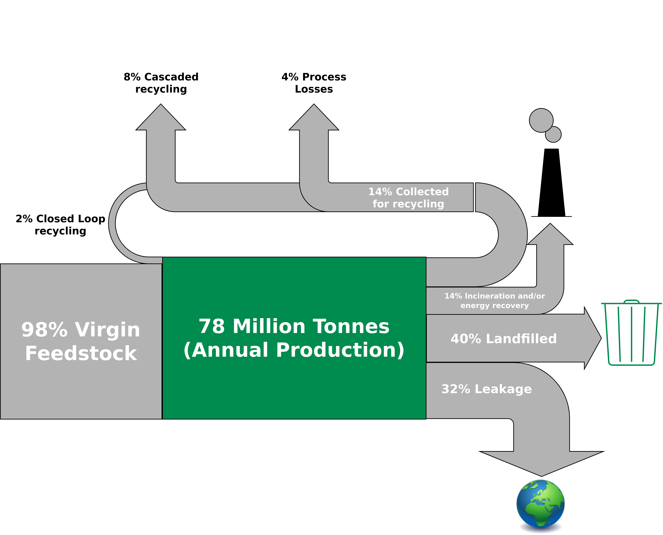
Environmental Pollution
Global Flows of Plastic Packaging Materials in 2013
Figure adapted from: Ellen MacArthur Foundation (2016) – THE NEW PLASTICS ECONOMY

Slide 31
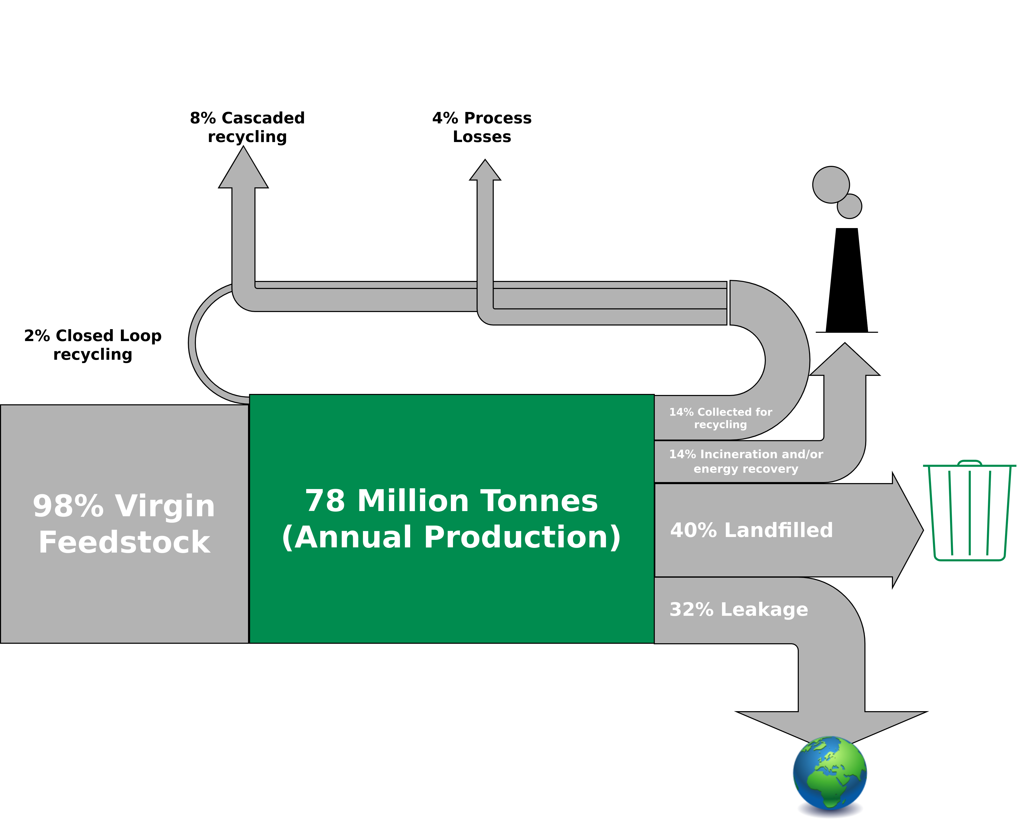
Environmental Pollution
Global Flows of Plastic Packaging Materials in 2013
In 2050, there will be more plastic than fish in the ocean (by weight) is a credit card every week!
That’s approximately 21 grams a month, or just over 250 grams a year.
Figure adapted from: Ellen MacArthur Foundation (2016) – THE NEW PLASTICS ECONOMY

Slide 32
Environmental Pollution
The Limits to Recycling
Recycling often requires a lot of energy
Some materials cannot be recycled at all (yet)
Impurities are challenging
Often requires a lot of manual labor
Recycled material often with lower quality than input material
False sense of safety!
I am not saying you should stop recycling!
→ Recycling is great but it is better to make sure that we do not have to recycle anything.
→ Buying less (only the essentials) is way more effective than recycling.

Slide 33
Environmental Pollution
The Limits to Recycling
Recycling often requires a lot of energy
Some materials cannot be recycled at all (yet)
Impurities are challenging
Often requires a lot of manual labor
Recycled material often with lower quality than input material
False sense of safety!
I am not saying you should stop recycling!
→ Recycling is great but it is better to make sure that we do not have to recycle anything.
→ Buying less (only the essentials) is way more effective than recycling.

Slide 34
Environmental Pollution
The Limits to Recycling
Recycling often requires a lot of energy
Some materials cannot be recycled at all (yet)
Impurities are challenging
Often requires a lot of manual labor
Recycled material often with lower quality than input material
False sense of safety!
I am not saying you should stop recycling!
→ Recycling is great but it is better to make sure that we do not have to recycle anything.
→ Buying less (e.g., only the essentials) is way more effective.
“We buy things we don't need, to impress people we don't like.” - Tyler Durden / Chuck Palahniuk

Slide 35
Conclusion

Slide 36
Conclusion
Personal carbon footprint and greenwashing
Basic concepts and definitions related to sustainability, resources, environmental pollution
The limits to recycling

Slide 37
Exercise E03

Slide 38
Exercise E03
Household Waste
Get the largest jar that you can find (either at your own place, or ask your friends).
Collect all the trash that you are producing in the upcoming week (except for bio-waste that is supposed to go into the green trash bin) – starting on Thursday (04.05.2023 – 00:01) until Tuesday (09.05.2023 – 23:59).
How many days of trash can you fit into your jar?
Submit your result according to the submission guidelines posted in the exercise sheet → E03.

Slide 39
Additional Resources
Baccini et al. (2012) – Metabolism of the Anthroposphere: Analysis, Evaluation, Design
Podcast How to Save a Planet – “Sacrifice Zones: ProPublica Takes Us Inside America’s Toxic Hotspots (2022) – Link

Slide 40
Questions?

